Slide 1
Accessibility is Critical to Data Visualization (And what you can do about it) Frank Elavsky, Data Experience Engineer

Slide 2
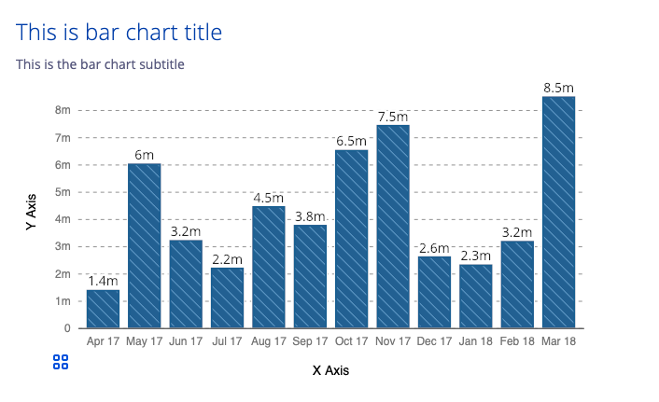
What do I do?
I am a Staff Data Experience Engineer on Visa’s DX Team.
Our Stack:
Data Visualization (D3.js).
Web Components (Stencil).
Visa Design Systems (VDS).
Open source here:
www.github.com/visa/visa-chart-components

Slide 3
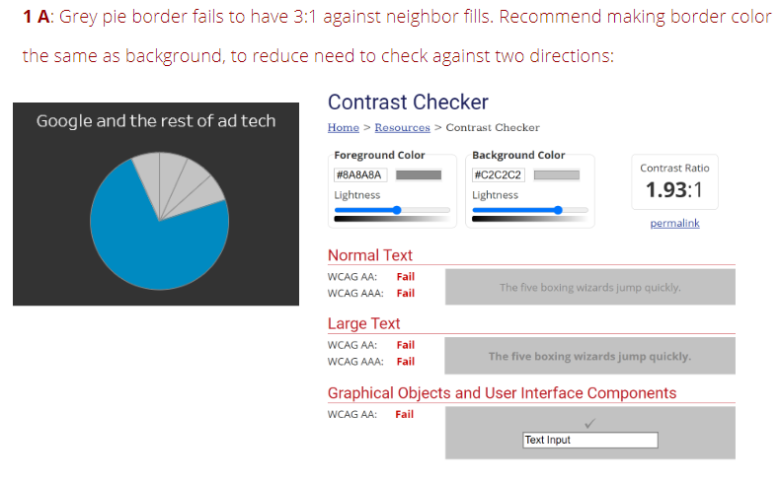
My Passion: Accessible data experiences
Despite my professional work involving accessibility, I am actually representing a project I’ve developed outside of Visa:
An auditing system for viz.

Slide 4
Before we begin.
If you post screenshots of this talk or slides around on Twitter or wherever (and please do), remember:
Add alt text to your post!

Slide 5
What is Accessibility (a11y)?
The qualities that make an experience open or usable to all.
The knowledge and skills to build products and services to be usable by people with disabilities.

Slide 6
What is Data Visualization?
Data Visualization (also sometimes abbreviated as dataviz or datavis) is presenting data in a structured, symbolic way.
The structure and semantics go beyond the visual however, so we prefer to call these data experiences.

Slide 7
Data visualization has work to do
“Virtually no visualizations I encounter in the wild are even remotely accessible.” – real screen reader users.
Outlier plans to release recordings from my talk within a week, which has these video interviews in them.

Slide 8
Public dataviz is especially is in trouble
Every major US news organization had a visualization on their landing webpage during the 2020 US Presidential Elections.
Sarah Fossheim and I (combined) audited 15 total and found none of them to be fully accessible.
See Sarah’s write-up, which looks at visualizations from NYT, CNN, FiveThirtyEight, The Guardian, and Fox News.

Slide 9
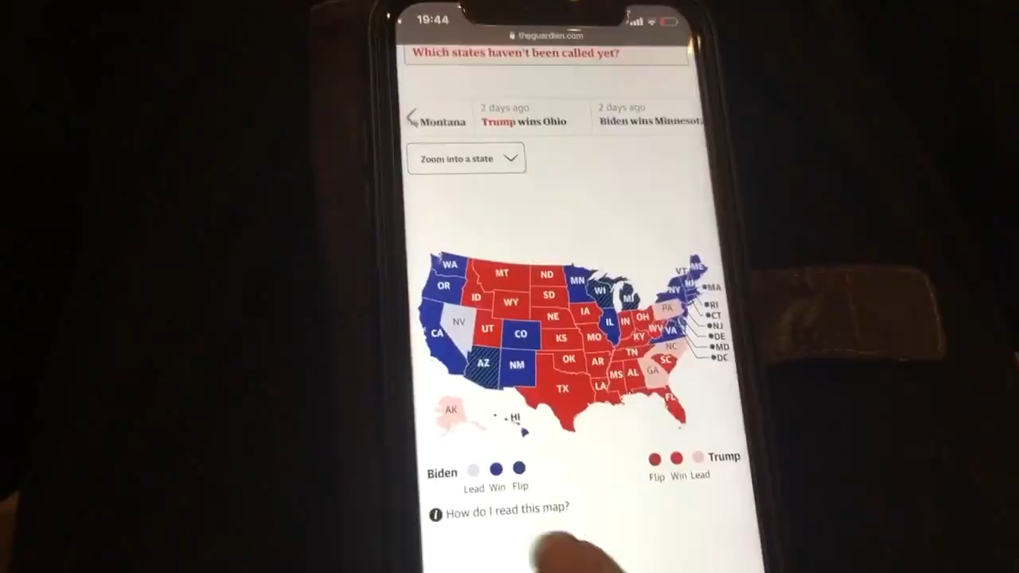
Data is painful. Visualization shouldn’t be.
Sarah’s video on Twitter

Slide 10
Cut to the chase:
Everyone should be able to tell whether or not a data visualization is accessible.
You might not be able to do this easily by the end of this talk, but you’ll have some tools to help you get there.

Slide 11
The best way to learn: evaluation.
The practice of evaluating something according to a consistent system of tests and standards is called an audit.
Anyone can learn how to audit! Designers, engineers, managers, analysts, scientists… really, anyone.

Slide 12
Today we will be talking about auditing.
I’ll give you some background and a pitch for doing the work of accessibility.
Then we jump right in and I walk you through the results of an audit.

Slide 13
Resources in this talk:
Workbook: fizz.studio/files/chartability-worksheet
Slides: fizz.studio/files/chartability-deck
Website: chartability.fizz.studio/

Slide 14
Why make something accessible?

Slide 15
Accessibility is the right thing to do
The United Nations’ Disability Right to Life article states:
“… every human being has the inherent right to life and [states] shall take all necessary measures to ensure its effective enjoyment by persons with disabilities on an equal basis with others.”
Link to the UN’s Right to Life, Article 10 of the Convention on the Rights of Persons with Disabilities

Slide 16
Inaccessible experiences are expensive
Exclusion of ~25% of all people is a poor business model.
Litigation is costly.
Brand damage.
Loss of alt text SEO.
Adding it in later is far more expensive than doing it from the start.
See: Dominos lawsuit

Slide 17
Accessibility is compelling work
Accessibility is already at the heart of data visualization! Why stop innovating only partway?
Accessible data experiences are the future – you will be embarking into uncharted spaces.
See Doug Schepers’ Accessibility is at the Heart of Data Visualization.

Slide 18
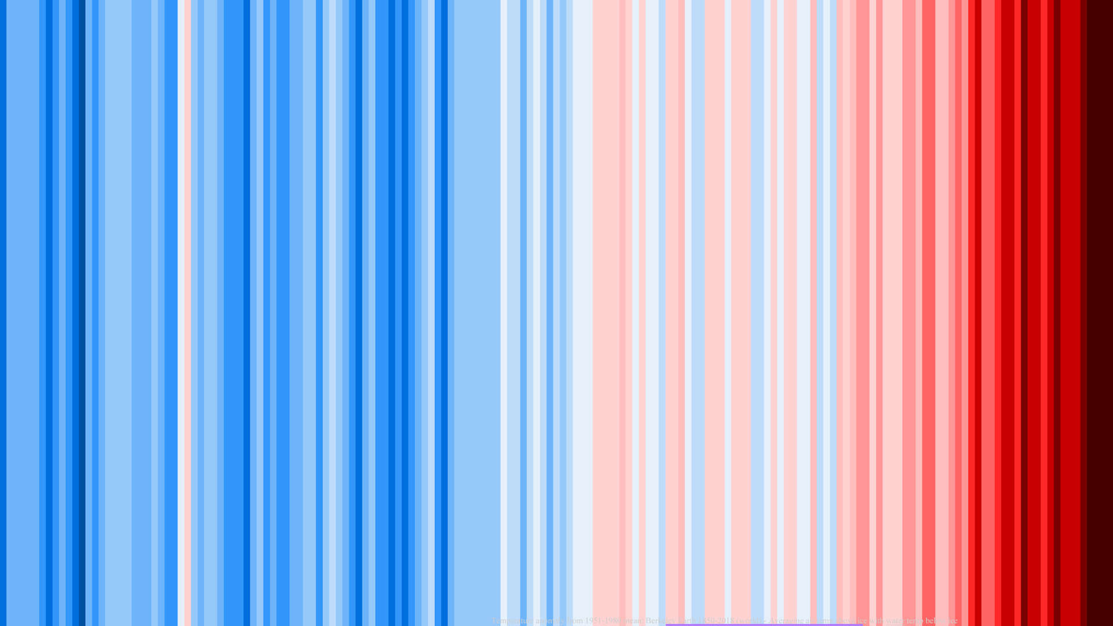
Auditing Viz is an Advanced Topic!
Even though this workshop is designed to be introductory, general, and high level, data visualization and accessibility is still a pretty advanced topic.
So we are going to start with some of the basics, first!
Climate Stripes: By RCraig09 - Own work, CC BY-SA 4.0, https://commons.wikimedia.org/w/index.php?curid=80170624

Slide 19
“I already use colorblind safe palettes. I don’t even need to be here!”
Check out my twitter thread, if you have not already.

Slide 20
Color vision deficiency (CVD), commonly referred to as “colorblindness” affects an estimated 4% of people worldwide.

Slide 21
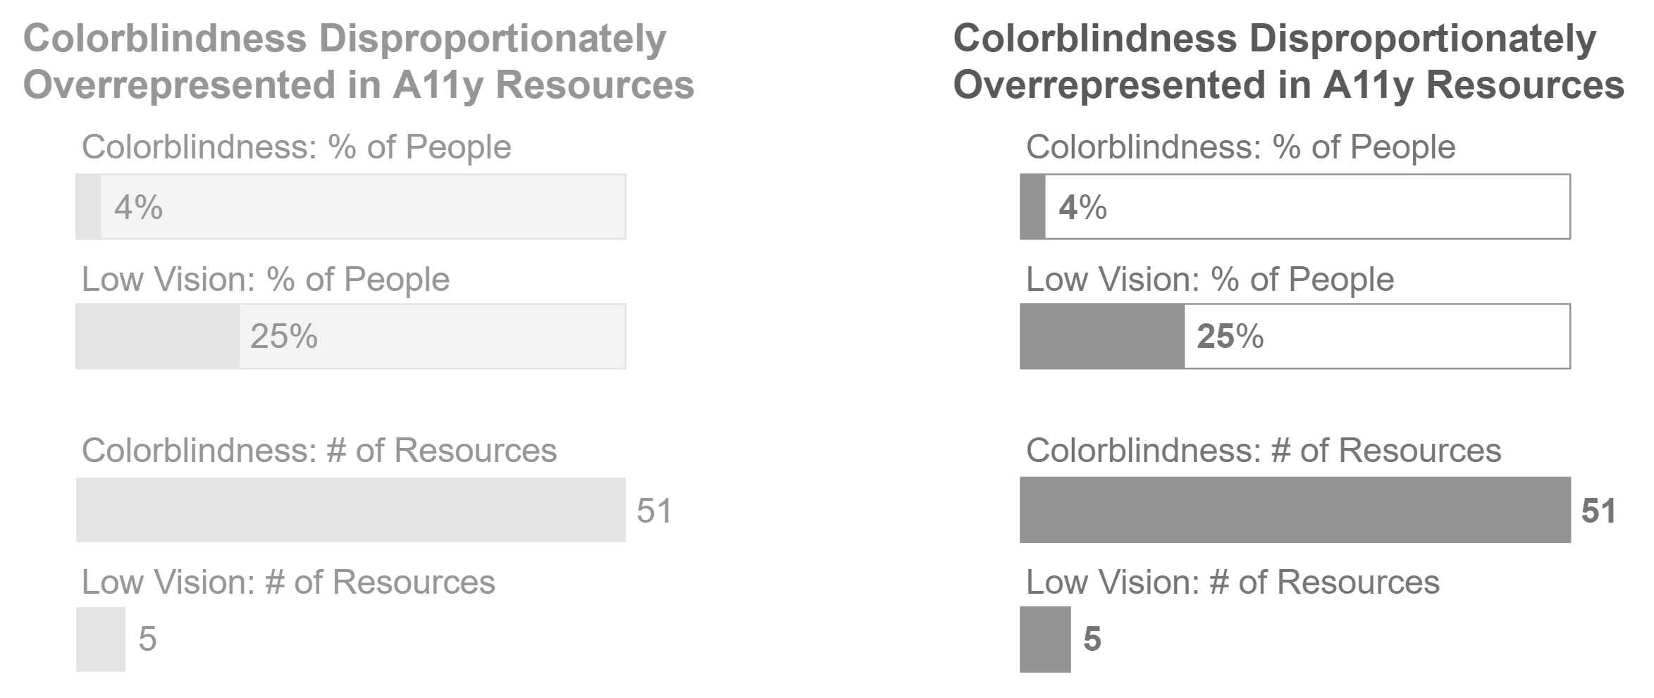
But do you design your viz for visual impairment, which affects ~25% of people globally?

Slide 22
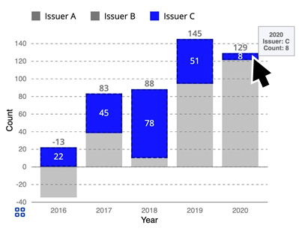
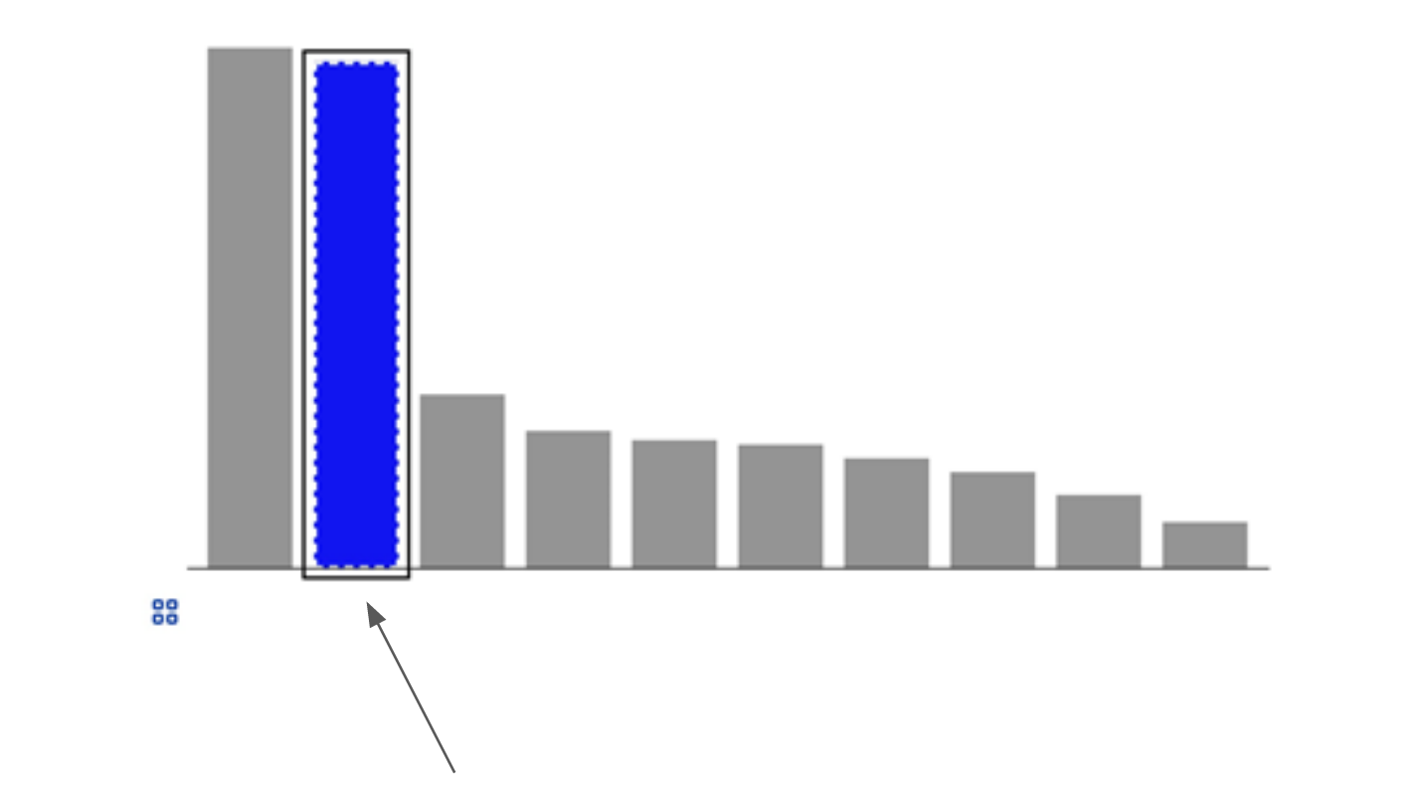
Motor impairment and functional disability (13-15%)?

Slide 23
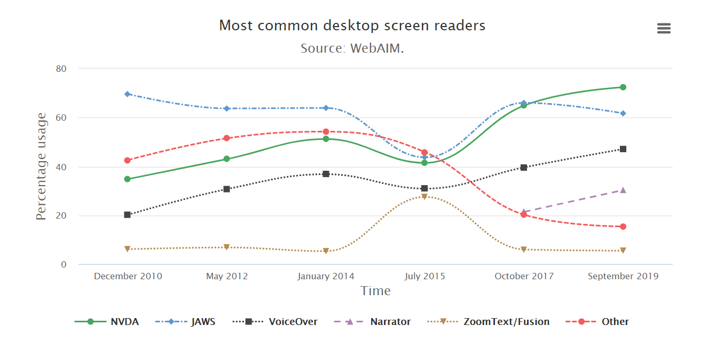
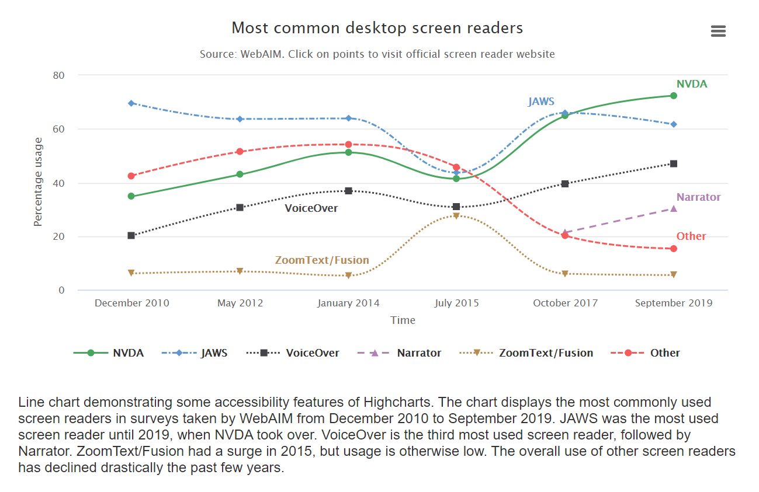
Cognitive and attention impairment (11-13%)?
Source: Highcharts example (an accessibility-focused charting library).

Slide 24
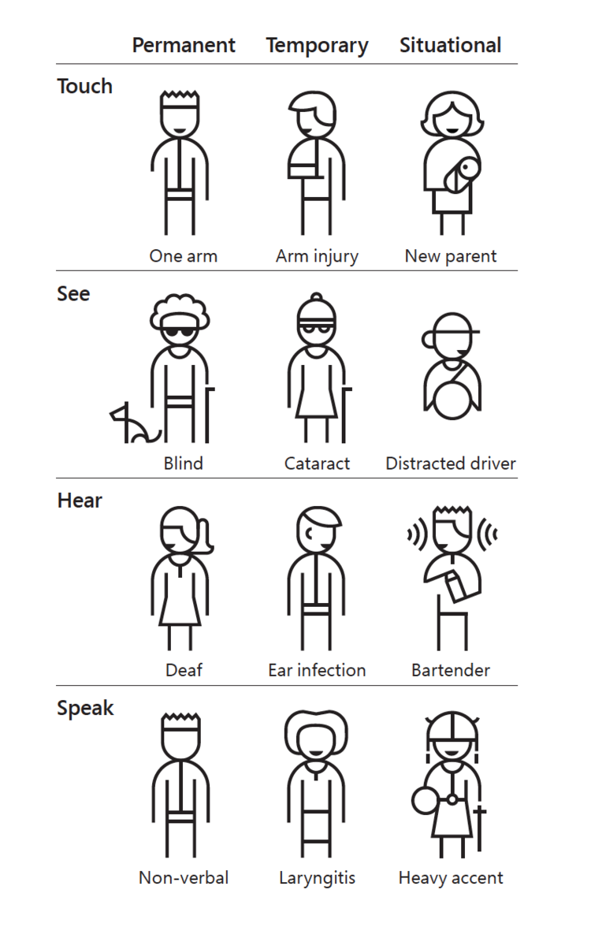
Accessibility is multi-dimensional
Some disabilities are permanent. Others are temporary or situational.
Source: https://www.microsoft.com/design

Slide 25
We have all already experienced disability at some point in our lives – even if just temporarily or situationally. We call this “experiencing a limitation.”

Slide 26
Disability is personal for all of us.

Slide 27
Is your data critically important? World-shattering information?
It had better be accessible.

Slide 28
The best time to make a data visualization accessible was when you first made it.
The second best time is now.

Slide 29
Where do I start?
3 steps:
Bring in outside expertise to provide auditing and guidance.
Involve people with disabilities in your work at every stage (and compensate them as subject matter experts).
Build up your skills internally.

Slide 30
We only cover this part here:
3 steps:
Bring in outside expertise to provide auditing and guidance.
Involve people with disabilities in your work at every stage (and compensate them as subject matter experts).
~> Build up your skills internally.

Slide 31
So, how do you build up skills?
Ideally: Look to standards.

Slide 32

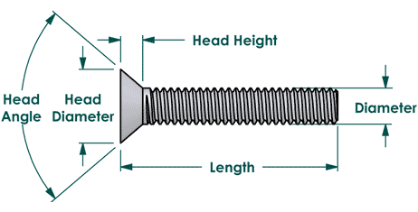
Why standards?
Industrial standards are what separates any given hex code from a Pantone color or a wood fastener from a Philips screw.

Slide 33
Standards rule.
Standards elevate content to a place of excellence: consistent and delightful user experience with an efficient and industrial scale of production.
The time has come for data interaction design to standardize. Accessibility must be part of this movement.

Slide 34
The State of a11y Standards: WCAG
Web Content Accessibility Guidelines (or WCAG) is currently adopted in policy in some form or another by many countries in the world.
It is the biggest and best set of standards out there.
WCAG homepage and WCAG policy adoption internationally

Slide 35
But data visualization is complex
Some of the practices in visualization explore areas outside of WCAG guidance. Navigating what should and shouldn’t be considered can be hard, even for accessibility experts.
I gave an advanced talk at AccessU 2020 on navigating data structures in visualizations and handling the semantics for interactive chart elements. This is uncharted territory! (pun intended).

Slide 36

Introducing: The Chartability Audit for Data Visualization

Slide 37
Chartability
Chartability is an audit approach specific to data visualization.
The goal is not to meet “compliance” but instead identify common design failures as early as possible.
“Passing” Chartability doesn’t mean the work is done, but that it is likely on the right path towards accessibility.

Slide 38
Chartability’s Principles
Chartability is organized into 7 principles, 4 common to the accessibility space:
Perceivable,
Operable,
Understandable, and
Robust (POUR)
Plus 3 more that extend from Robust:
Compromising
Assitive
And Flexible (CAF)

Slide 39
POUR
POUR is an acronym that refers to broad accessibility principles across four functional groups:
Perceivable
Operable
Understandable
Robust
These pillars can help guide user experience evaluation specific to accessibility.
See: https://uiowa.instructure.com/courses/40/pages/accessibility-principles-pour

Slide 40
+CAF
CAF is an acronym that I added to POUR to address specific user experience principles useful to data visualizations:
Compromising
Assistive
Flexible
These pillars are inspired by Inclusive Design principles and address areas common to complex, interactive data systems (like dashboards, applications, and data-driven interfaces).
https://inclusivedesignprinciples.org/, (CC BY-SA) Henny Swan, Ian Pouncey, Heydon Pickering, & Léonie Watson

Slide 41
POUR+CAF: recap
POUR is a set of accessibility heuristics principles.
CAF is inspired by inclusive design principles.
Both are reframed to focus on making effective data experiences.

Slide 42
Why I came up with Chartability
There is no universal standards yet for data visualizations (and a set of testable heuristic principles is the first step).
I needed to have a convenient, consistent tool for auditing things quickly in any environment and stage of development.

Slide 43
Scope of Chartability
Chartability has 45 total failures that you can test for, each take about one minute if you’re used to them. All in all, you can get a good sense of whether or not a visualization is on the path to accessibility in less than an hour.
But Chartability also has a top-10 Critical Failures: the most essential requirements to pass. These can be evaluated in 10 to 20 minutes and give early warning signs.

Slide 44
Chartability anywhere
Chartability is largely applicable to any environment a visualization may be found: from Excel, PDFs, python, Tableau, R, SAS, Matlab, the web, or wherever.

Slide 45
Chartability anytime
Chartability can be used in combination with a full compliance review to vet a nearly-finished MVP, during development as ongoing editorial support, or early on to guide design before it begins.

Slide 46
Chartability is a living document
Chartability has a lot of room to grow. And I hope that it does! I am part of a working group in my spare time, hoping to develop robust, industrial-grade, standards for data visualizations. This is just one piece of our efforts.
You can find the repository that represents this project here. Feel free to open issues, give feedback, or contribute!
You can also follow our group or just follow me via twitter to stay up to date with all of the things we are involved in.

Slide 47
Chartability: Top 10 Critical failures
We will be going through Chartability to break down the most critical data visualization design failures.

Slide 48
Chartability: Example Audit
Chris DeMartini (multi-year Tableau Zen master) offered up some of his viz to be critiqued.
His Coin Flip game fails 7 of the 10 Critical tests.
You can follow along here, if you would like: https://public.tableau.com/profile/vizde7382#!/vizhome/CoinFlipGame/CoinFlipGame

Slide 49
Perceivable
User must be able to easily identify content using their senses: sight, sound, and touch.

Slide 50
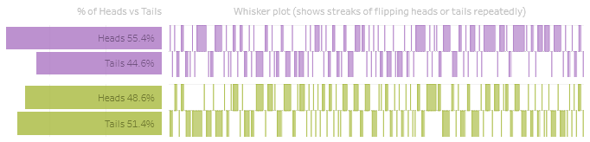
Critical Perceivable Failures (1/10)
Low contrast on chart elements and text: FAIL
Target: Text needs 4.5:1, Geometry 3:1
Solution: Darken text, ensure geometry has 1px dark border.
Grey text fails. 1.81:1
Purple text fails. 2.47:1
Purple geometry (no border) fails. 2.63:1
Green geometry (with border) fails. 1.98:1
Green text fails. 2.59:1

Slide 51
Critical Perceivable Failures (2/10)
Text size too small: FAIL
Target: No text smaller than 12px.
Solution: Increase size to 12px.
Text fails. 11px size.

Slide 52
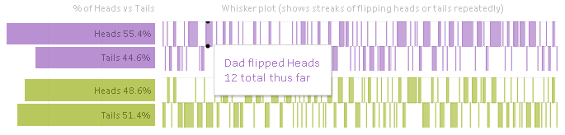
Critical Perceivable Failures (3/10)
Information only available visually: FAIL
Target: Tooltips expose on keyboard navigation, summary information inside tooltips and around chart is read by screen reader.
Solution: Ensure tab and key navigation takes place on the elements. Expose text to screen readers.
Tooltip and heading information not exposed. Chart has minimal screen reader announcements.

Slide 53
Operable
All controls must be error-tolerant, discoverable, and multi-modal (not just mouse operable, but using keyboard, voice, etc).

Slide 54
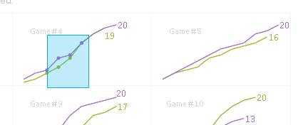
Critical Operable Failures (4/10)
Chart is interactive through only one means: FAIL
Target: Chart interactivity (tooltips, brushing) can be used without mouse.
Solution: Ensure the functionality provided is either exposed to screen reader users or removed (it appears to serve little purpose).
Tooltip and brush not exposed. Chart requires mouse to use.

Slide 55
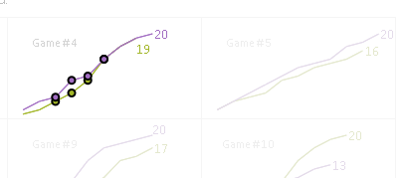
Critical Operable Failures (5/10)
No instructions provided for interaction: FAIL
Target: Chart interactivity (tooltips, brushing) must be explained.
Solution: Ensure all functionality provided is explained. If it is not used for any purpose, it should be removed.
Tooltip and brush not explained. This brush action accomplishes nothing.

Slide 56
Understandable
Any information or data are presented without ambiguity, with clarity, and in a way that minimizes cognitive load
Note: if the data has statistical uncertainty, then it must be clearly communicated (this is not considered “ambiguity”).

Slide 57
Critical Understandable Failures (6/10)
Chart is novel or unconventional with no explanation or introduction: PASS
Target: Non-standard or uncommon chart types must have an explanation for what they mean and how to read them.
Feedback: Guidance for how to read whisker plot should be added.
Acceptable, but not great.

Slide 58
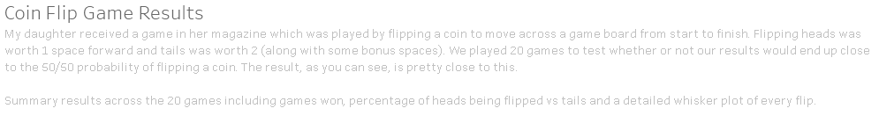
Critical Understandable Failures (7/10)
No title, summary, context, or caption provided: PASS
Target: Title, summary, context, or caption should be provided.
Feedback: Title should be improved to explain what the results actually were, such as “Coin Flip Game Produces Consistent Balance.” (Explaining the outcome in the title itself is more accessible.)
Acceptable, but not great.

Slide 59
Robust
The design is compliant with existing standards and works with the user’s compliant, assistive technology of choice.

Slide 60
Critical Robust Failures
(Skip! Robust has no Critical failures to test.)

Slide 61
Compromising
Information can be approached at both a high and low level. Layout, flow, actions, and tasks all have alternatives. The user has the choice how they want to engage.

Slide 62
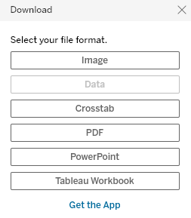

Critical Compromising Failures (8/10)
A table is not provided that the chart is based on: FAIL
Target: Table should be provided that is formatted and human-readable.
Solution: Provide access to the data in a functional download somewhere that is formatted and easy to parse.
Disabled in Chrome.
Nothing shown in Firefox.

Slide 63
Assistive
“Heavy lifting” (difficult/manual statistical or data-related) tasks are automatically handled or assisted whenever possible.

Slide 64
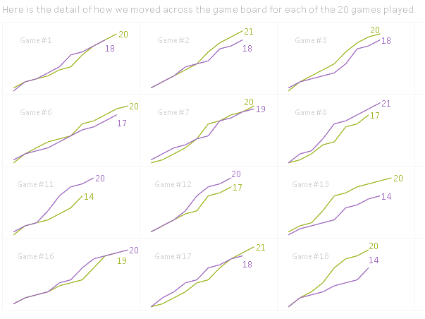
Critical Assistive Failures (9/10)
Too much data displayed at once: PASS
Target: Try not to have more than 20 elements competing for the same space.
Feedback: Small multiples (each game its own pair of lines) is a good treatment for this data.

Slide 65
Flexible
Styling and presentation can be altered and adjusted according to user preference.

Slide 66
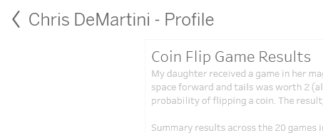
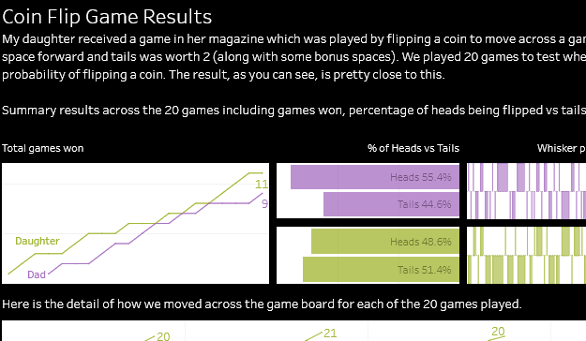
Critical Flexible Failures (10/10)
Styling cannot be changed by the user: FAIL
Target: Text, colors, and high contrast controlled by the user must be respected. Chart must respond according to user settings.
Solution: Tableau’s iframe does not detect stylesheets loaded (text) and chart space (geometries) do not respect Windows High Contrast mode.
“Chris DeMartini” changed size, but this text did not.
High Contrast not detected.

Slide 67
Chartability Audit Result: 3/10 Passing

Slide 68
More resources:
Follow me on twitter for news about Chartability (@frankElavsky).
About the group I am a part of: github.com/dataviza11y/Why-We-Exist
Our Group’s resources for visualization and accessibility.
Chartability Workbook: fizz.studio/files/chartability-worksheet
Chartability Slides: fizz.studio/files/chartability-deck
Chartability Website: chartability.fizz.studio/

